Slide 1
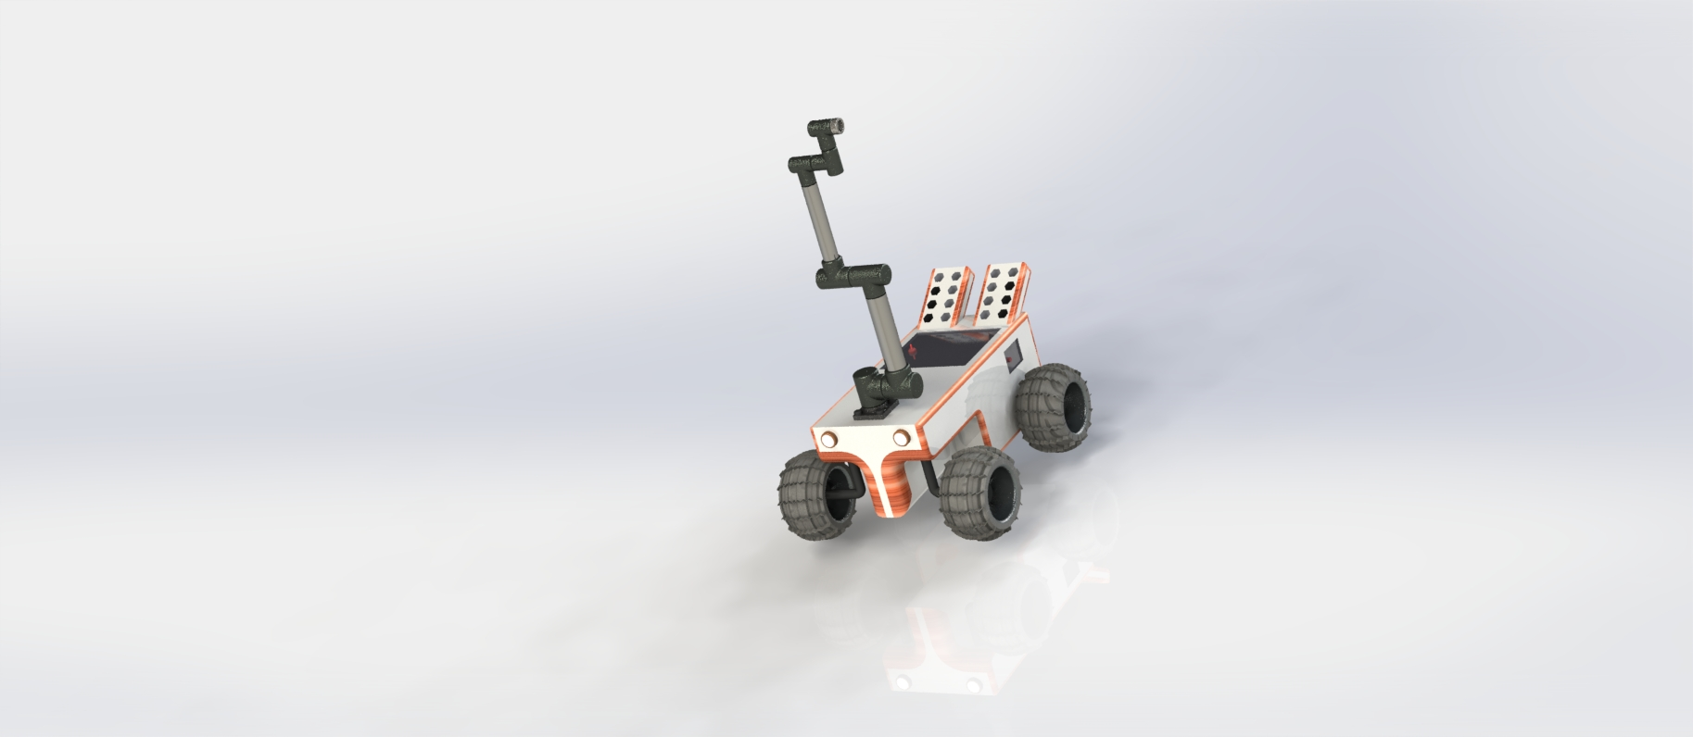

ENPM 662 – Introduction to Robot Modelling Project -2
Team -29
Piyush Goenka
Gautam Sreenarayanan Nair
Rover with Multipurpose arm
1
Presentation date: 12/05/2023

Slide 2

Introduction
Overview : Design of a Rover with manipulator arm with multipurpose capabilities.
Application : The manipular can perform multiple operations based on the end-effector and the rover has capability to carry multiple end effector tools. Here in this project, we have used vacuum gripper only for the purpose of demonstration.
Steps taken
-> CAD Modelling
-> URDF
-> Forward Kinematics and validation
-> Inverse Kinematics and validation
-> ROS2 nodes
-> Gazebo Simulation

Slide 3
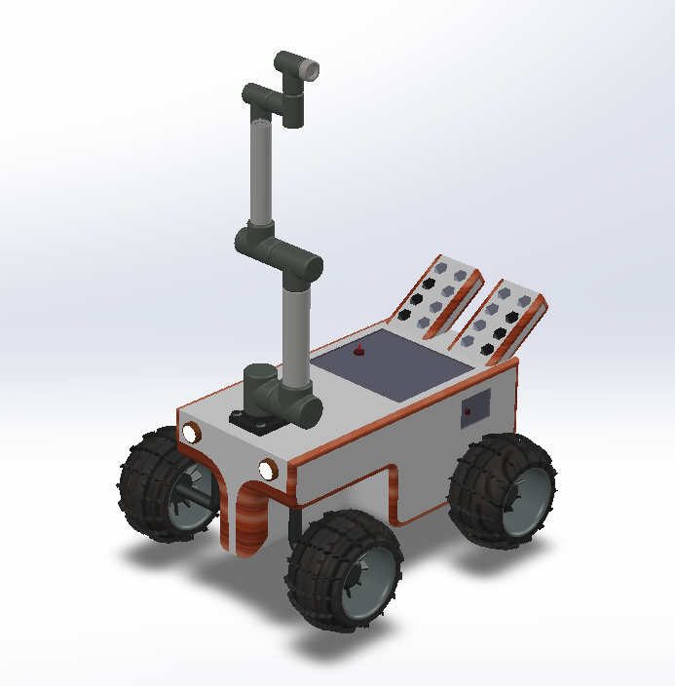
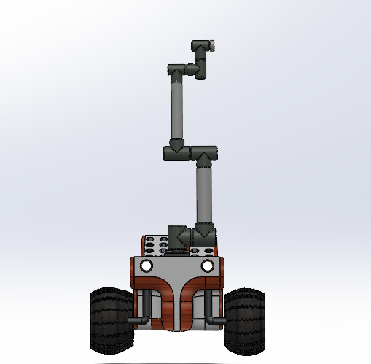
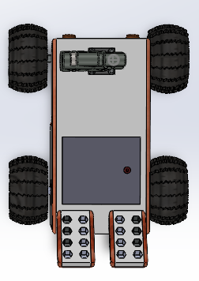
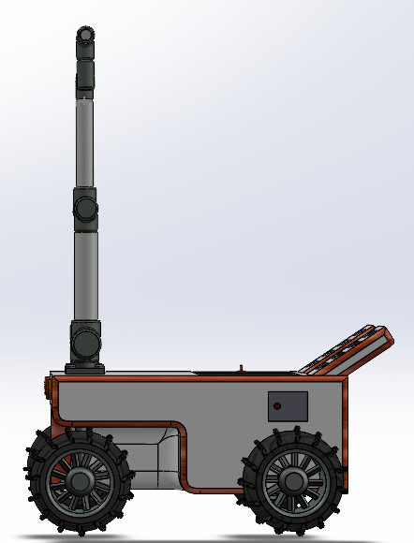

CAD Model

Slide 4
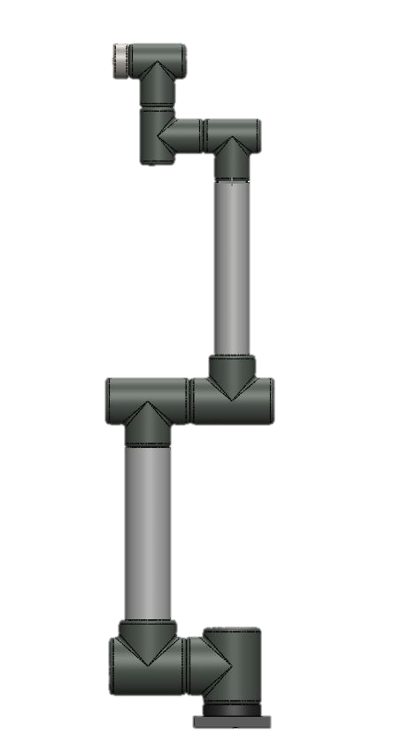

Z6
Z5
X6
X5
Z4
Z3
X4
X3
Manipulator Frames and Joint Rotations
Z2
X2
X1
Z1
Z0
Y0
X0
Note : The manipulator design in based on UR10 of Universal Robotics.

Slide 5
DH Parameter Table
Link | a_i | alpha_i (degrees) | d_i | Theta (degrees)
1 | 0 | -90 | 160 mm | theta_1
2 | -690 mm | 180 | 0 mm | theta_2 + 90
3 | -690 mm | 0 | 0 mm | theta_3
4 | 0 | -90 | -195 mm | theta_4+ 90
5 | 0 | -90 | 195 mm | theta_5
6 | 0 | 0 | 85 mm | theta_6

Slide 6
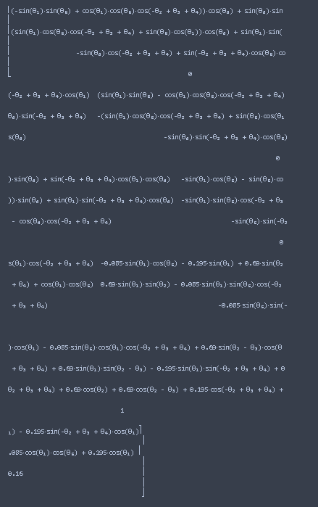
Final transformation matrix

Slide 7
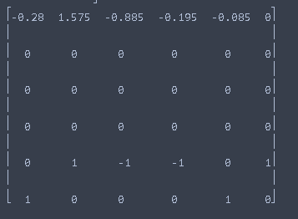
Jacobian Matrix
Jacobian matrix at
zero joint angles.

Slide 8
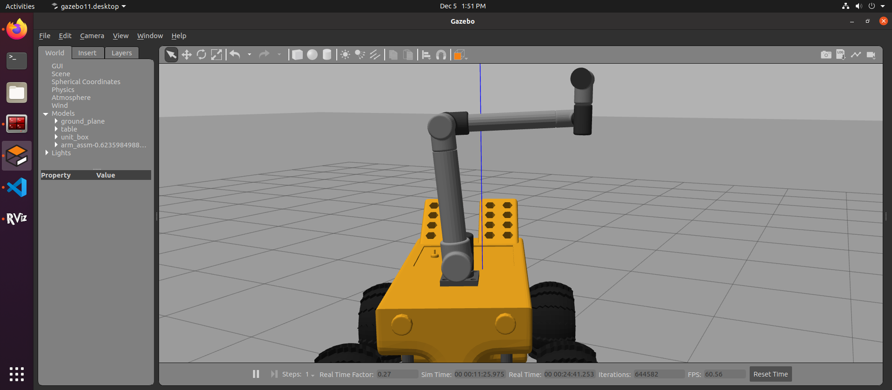
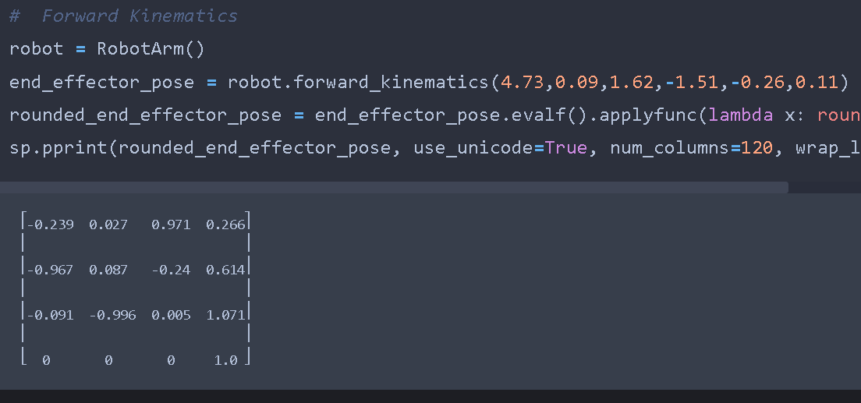
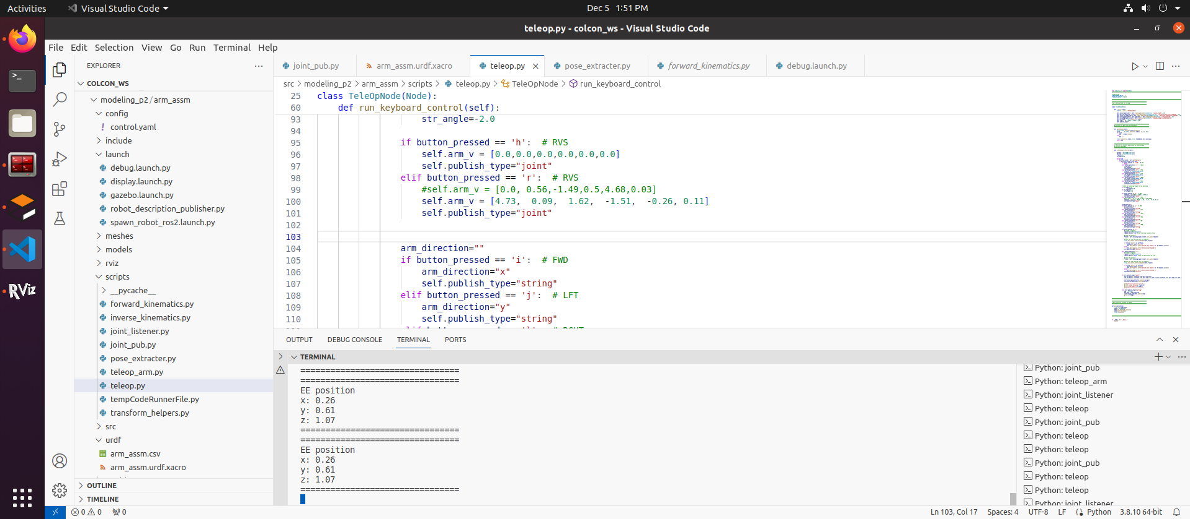
Forward Kinematics - Validation
Forward Kinematics - Validation
Configuration 1/3
Θ1 | Θ2 | Θ3 | Θ4 | Θ5 | Θ6
4.73 | 0.09 | 1.62 | -1.51 | -0.26 | 0.11
Sympy Output
Gazebo Output

Slide 9
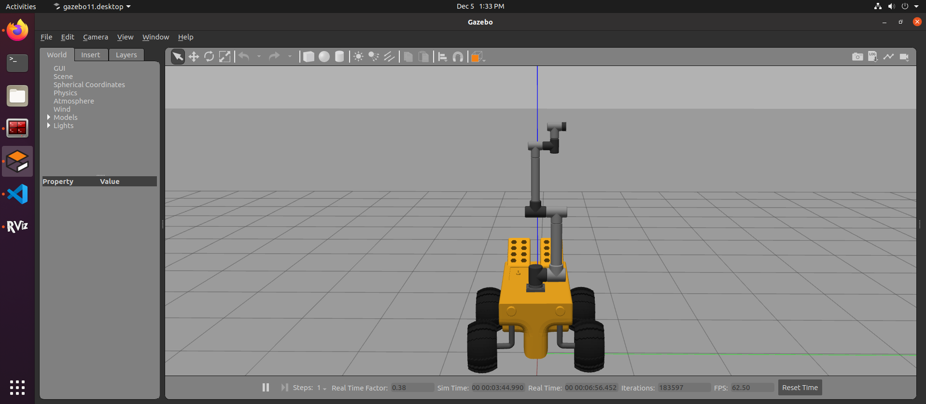
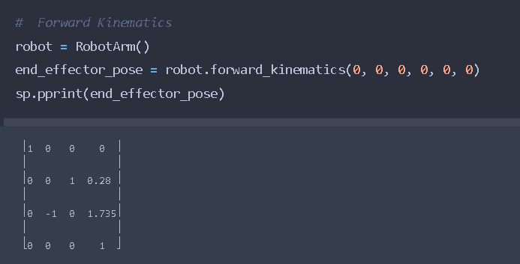
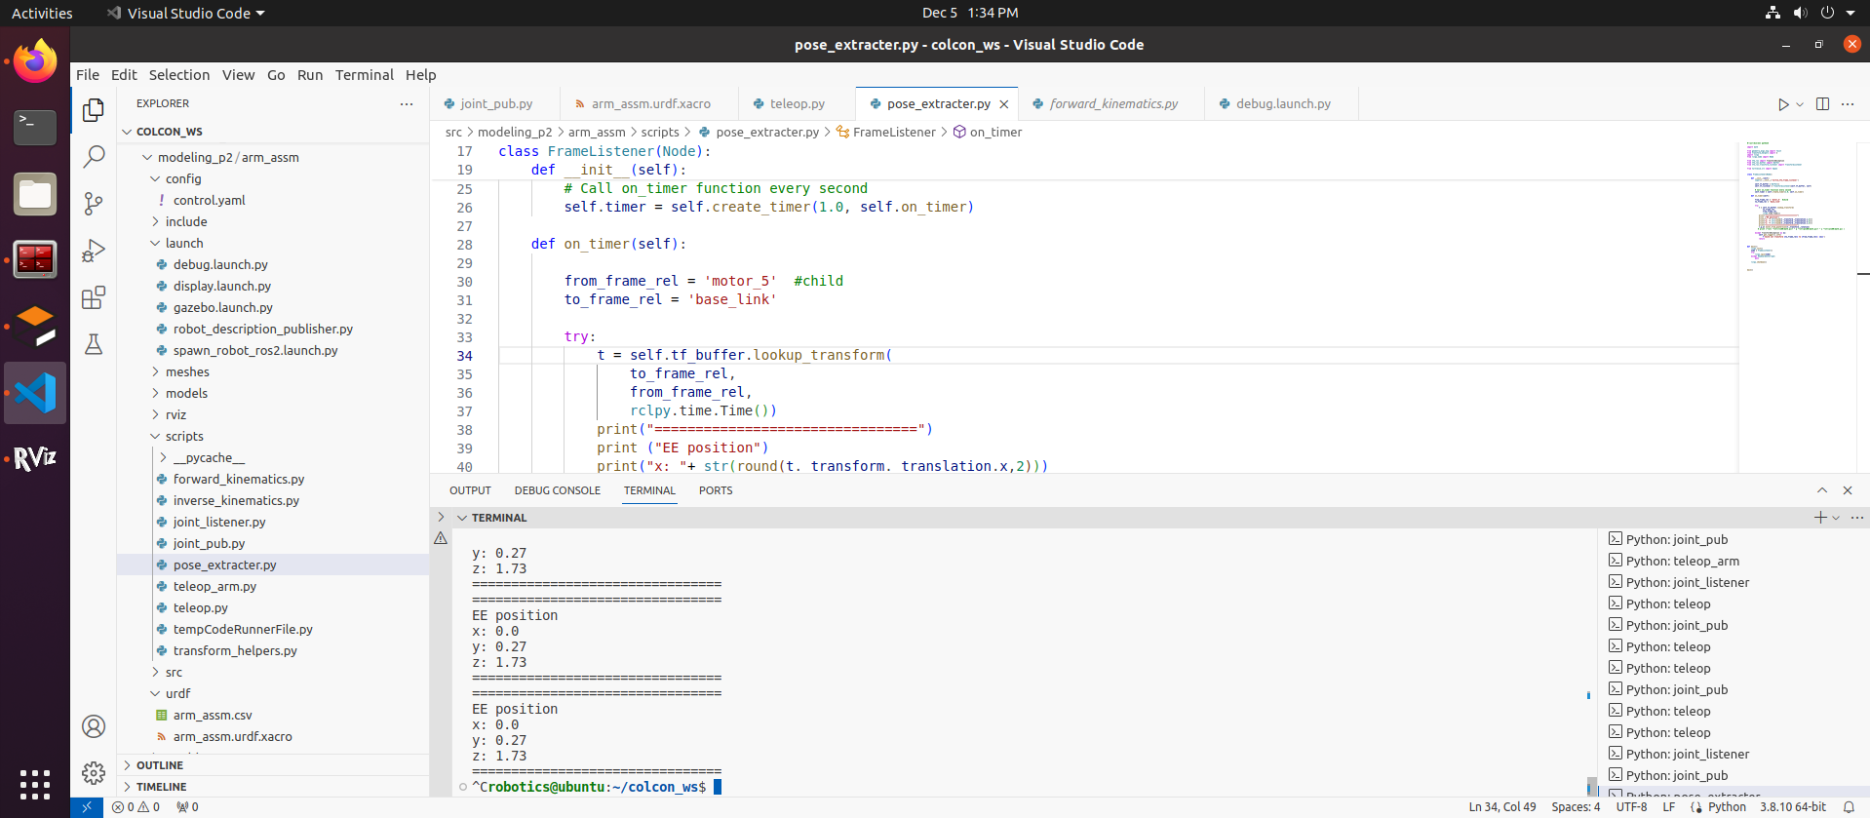
Forward Kinematics - Validation
Configuration 2/3
Θ1 | Θ2 | Θ3 | Θ4 | Θ5 | Θ6
0 | 0 | 0 | 0 | 0 | 0
Sympy Output
Gazebo Output

Slide 10
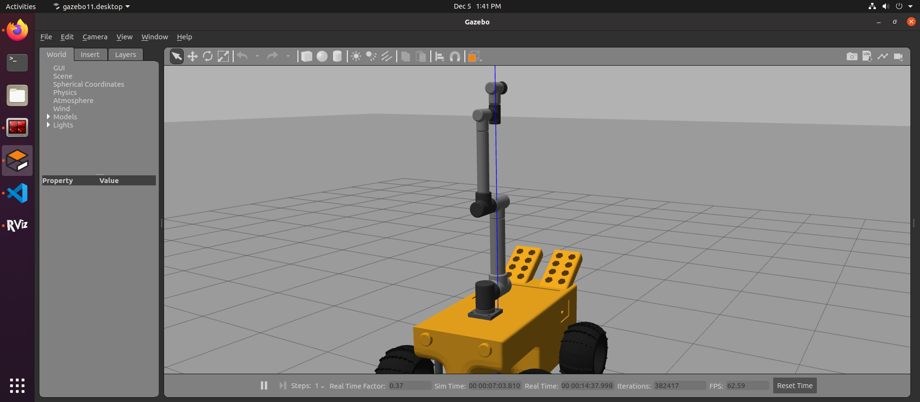
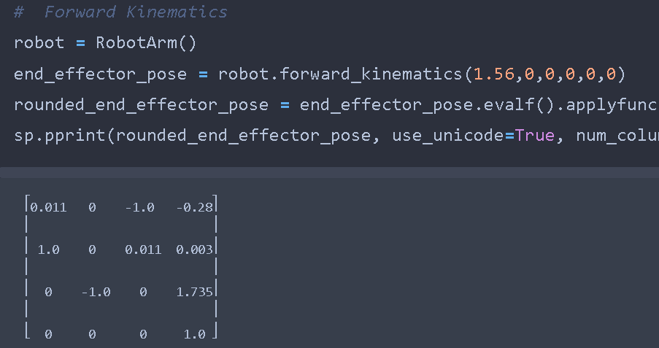
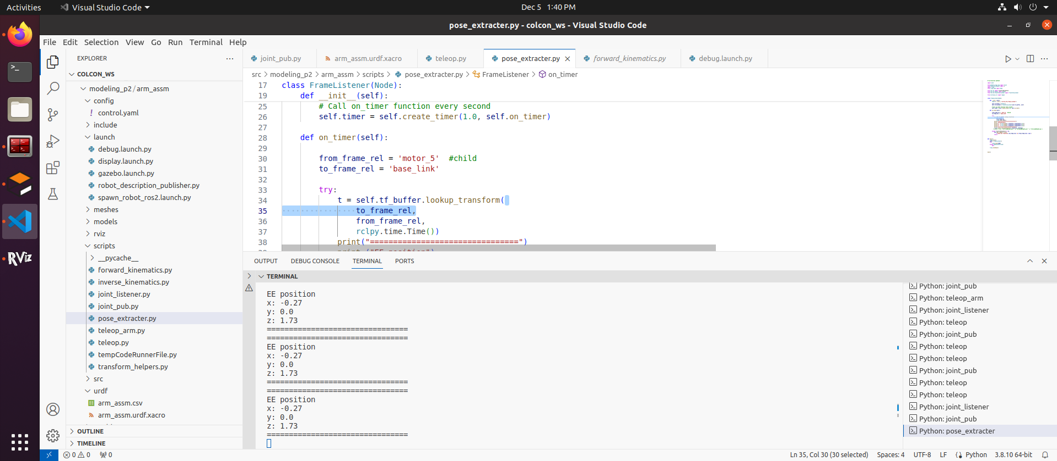
Forward Kinematics - Validation
Configuration 3/3
Θ1 | Θ2 | Θ3 | Θ4 | Θ5 | Θ6
1.56 | 0 | 0 | 0 | 0 | 0
Sympy Output
Gazebo Output

Slide 11

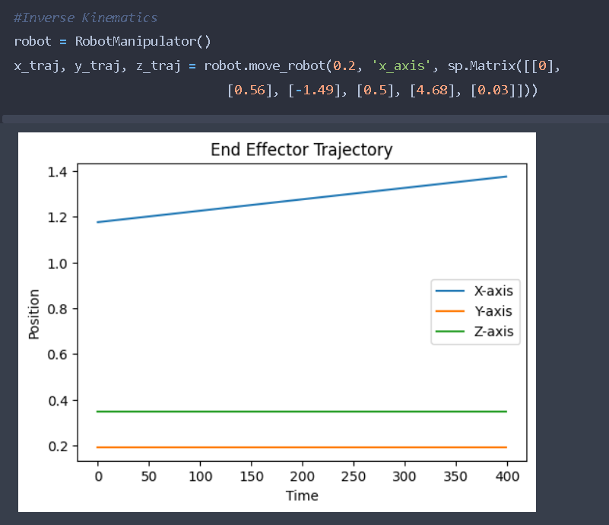
Inverse Kinematics - Validation
move_robot(self, distance, axis, q_current_initial):
move_robot has 3 inputs ;
Distance to be travelled -> 0.2 m (here)
Axis of travel -> x-axis (here)
Initial joint angles in radians -> (0,0.56,-1.49,0.5,4.68,0.03) (here)
Code Logic
linear_velocity = 0.01
end_time = distance/ linear_velocity
time=0
while time < end_time:
J_var = self.J.subs(q_current)
J_inv = J_var.inv()
q_dot = (J_inv) * end_effector_velocity.subs(t, time).evalf()
q_current = q_current + q_dot.evalf() * delta_t
time = time + delta_t
position = self.T06.subs(q_current)
1.37
1.17

Slide 12
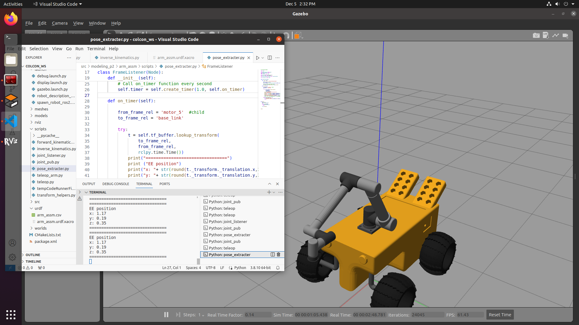
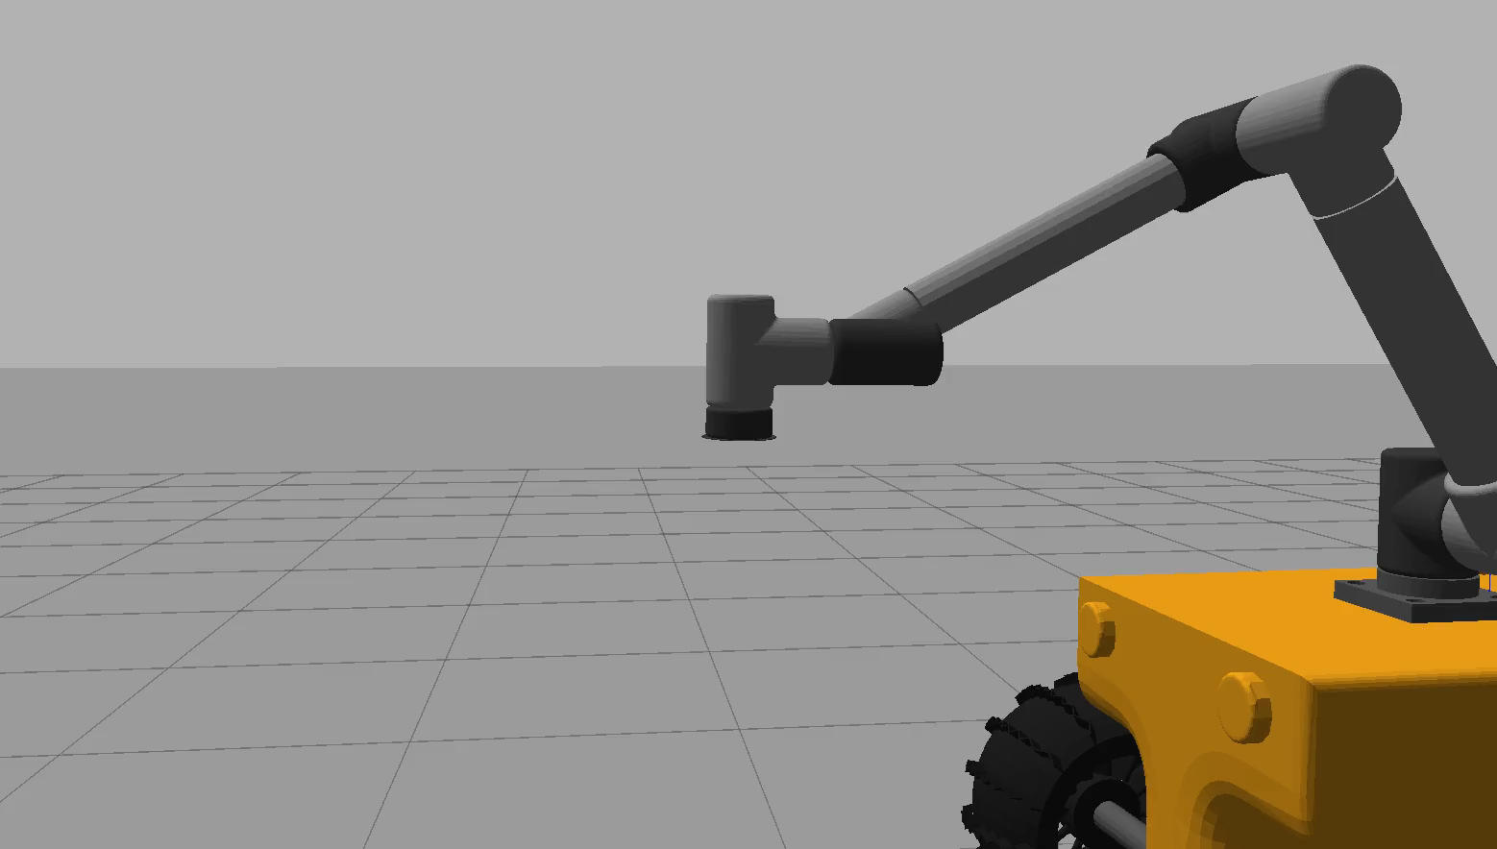
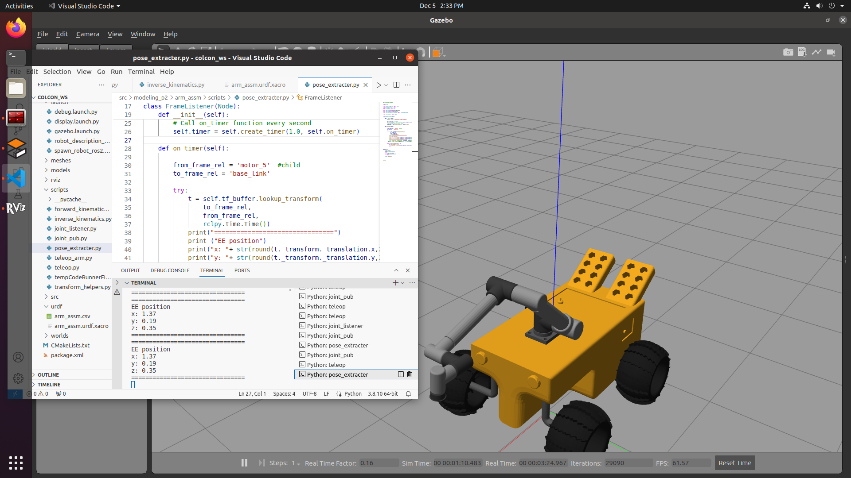
Inverse Kinematics - Validation
End Effector movement in +x direction for 0.2m
Start Position
End Position

Slide 13
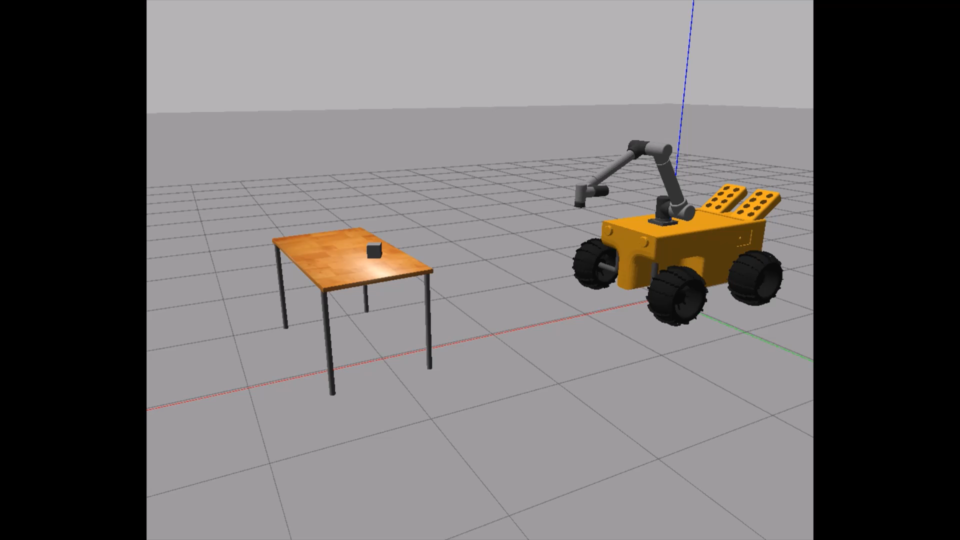
Gazebo Visualisation
Key | Command
W | Move Rover Forward
A | Steer Rover Left
S | Move Rover Reverse
D | Steer Rover Right
I | Move Arm Forward
J | Move Arm Left
K | Move Arm Backward
L | Move Arm Right
M | Move Arm Upwards
N | Move Arm Downward
C | Vacuum Gripper ON
V | Vacuum Gripper OFF
In the below scene, the robot is tele-operated using the keys described on the left. Then the box on the table is picked using a vacuum gripper which is attached at the end effector of the robot

Slide 14
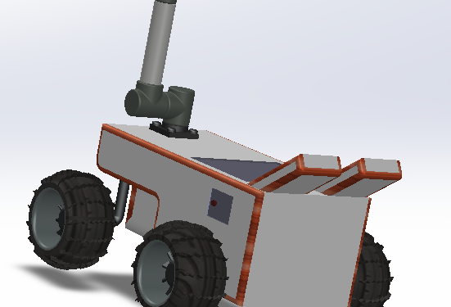
Thank You

